Slide 1
On the origins of the state: stationary bandits and taxation in eastern Congo (Raúl Sánchez de la Sierra, 2017)

Slide 2
Summary
Raúl Sánchez de la Sierra tries to explain the emergence and trajectories of the essential functions of the state
He gathers data about armed actors in eastern Congo and compares the changes in behavior if there is a demand shock for coltan / gold have
Armed actors respond differently on demand shocks for coltan and gold

Slide 3
What do states do?
Essential functions of the state (Tilly, 1985):
Eliminate external rivals and oppressing internal opponents (monopoly of violence)
Repressing threats to the property of the governed (protection)
Design means to finance these activities (taxation)

Slide 4
What do states do?
Archeological evidence suggests that states emerged when one group used coercion to extract taxes from a population
Two typical European states: English and French state
English state: revenues from international trade
→ taxes through customs, minimal administration required
French state: revenues from small-scale transactions
→monitoring, rural fairs, tolls, administration

Slide 5
Stationary bandits
Armed actors who are able to sustain a monopoly of violence in a given territory
They commit to taxation to design the means to finance war making and state making
Offer protection in order to provide incentives to invest and trade, since they benefit from it through taxation

Slide 6
Stationary bandits
Categorization of stationary bandits:
Village militia and regional militia, that emerge in the village from popular processes
External organizations, which are not from the area
Congolese army (basically external but represent interests of the population)

Slide 7
Implications
Monopolies of violence are more likely to form at production sites when the price output is higher
Monopolies of violence are more likely to form in the locations where households use their wealth when wealth in circulation is higher
Monopolies of violence at production sites whose output is easy to tax tax output and have a minimal administration. Monopolies of violence in locations where households invest their wealth tax returns on investment and develop an administration
The higher is the weight in her objective function that the monopoly of violence places on the population's payoff, the more likely the population benefits on net

Slide 8
Setting: macroeconomic environment
The study covers the Second Congo War (1998-2003) and the “post-conflict” period (2003-2013)
Congolese state struggles to regain control over the eastern provinces
In 2015, more than 70 armed groups operated in the east, controlling up to 95% of the territory in some districts
Armed groups discovered the profitability of organizing coercion along the mineral trade

Slide 9
Setting: macroeconomic environment
The author looks at demand shocks for two minerals
Distinguished by the value to weight: coltan ↔ gold
Coltan mines: bags up to 75kg, carried to support village, shipped by plane to global markets
→ Coltan output is easy to tax
Gold mines: small amounts
Miners can conceal gold to evade output tax

Slide 10
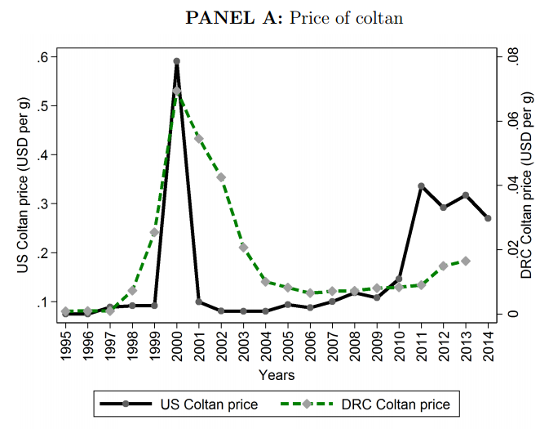
Setting: macroeconomic environment

Slide 11
Setting: microeconomic environment
Large number of municipalities

Slide 12
Setting: microeconomic environment
When output is easy to observe (coltan), armed actors often establish a monopoly of violence at the mining site
When output is difficult to observe and tax armed actors focus on taxing economic activity at the support village where miners spend their income

Slide 13
Results
What are the origins of taxation, stationary bandits, and protection?
Coltan shock induces armed actors to create stable taxation systems in coltan mines
Stationary bandits are twice more likely to emerge during the coltan shock in coltan sites than in the rest of sites
World price of coltan leads to the emergence of the essential functions of the state on the extensive margin
Rise in the price of gold leads to a significant extensive margin effect at the support villages → difficult to tax gold output

Slide 14
Results
Most coltan output accesses global markets through airplanes
Effect of the coltan price shock is concentrated in mines whose support village is closest to airport
The gold price shock leads to extensive margin effects at the support village, where the population spends their income

Slide 15
Results
Extensive margin effect of the coltan shock is driven by regional militia, external groups and the emergence of village militia
Gold shock changes the composition of stationary bandits → village militia and the Congolese army are more likely to control gold mines
The strongest armed actors (regional militia, external groups, and the army) sort into coltan mines during the coltan shock and gold villages during the gold shock
Village militia take the least profitable of the mine/village pair

Slide 16
Results
Stationary bandits raise head tax (60% of years), toll taxes and market taxes (40% of years)
Half of the stationary bandits manage the village fiscal administration and the legal administration of the village
Stationary bandits regulate traffic of persons 42% of the time
In 30% of the years stationary bandits are perceived as legitimate, face no opposition in 81% of the years
Provide security in 45% of the years

Slide 17
Results
Gold shock induces stationary bandits to collect more taxes and develop a fiscal and legal system
The coltan shock fails to produce this effect at the mines, indicating that the monopolies of violence created to tax coltan output involve minimal administrative capacity

Slide 18
Results
Stationary bandits increase the total surplus
The welfare of the houses increases most when the village is controlled by militia
External stationary bandits are associated with larger surplus, but the population does not benefit
Under a local militia the increase in household income is significantly larger under a local militia than with any other stationary bandit, and than without any stationary bandit

Slide 19
Recap
How do the functions of the state emerge?
Stationary bandits in eastern Congo and taxation
Armed actors often establish a monopoly of violence, tax, and protect if there is a stable surplus they can expropriate
When it is profitable, armed actors may create a fiscal administration to combat tax evasion, sophisticating their taxation practices, and creating a legal administration

