Slide 1
Law and Finance The Economic Consequences of Legal Origins
La Porta, Lopez-de-Silanes, Shleifer (and Vishny)
Notes:
Situation: Understand the connection between institutions and development
Complication: so far closer look at a most relevant institution: The Law
Question: When do we change that?

Slide 2
Structure
A. Law and Finance (1998)
B. The Economic Consequences of Legal Origins (2008)
C. Criticism

Slide 3
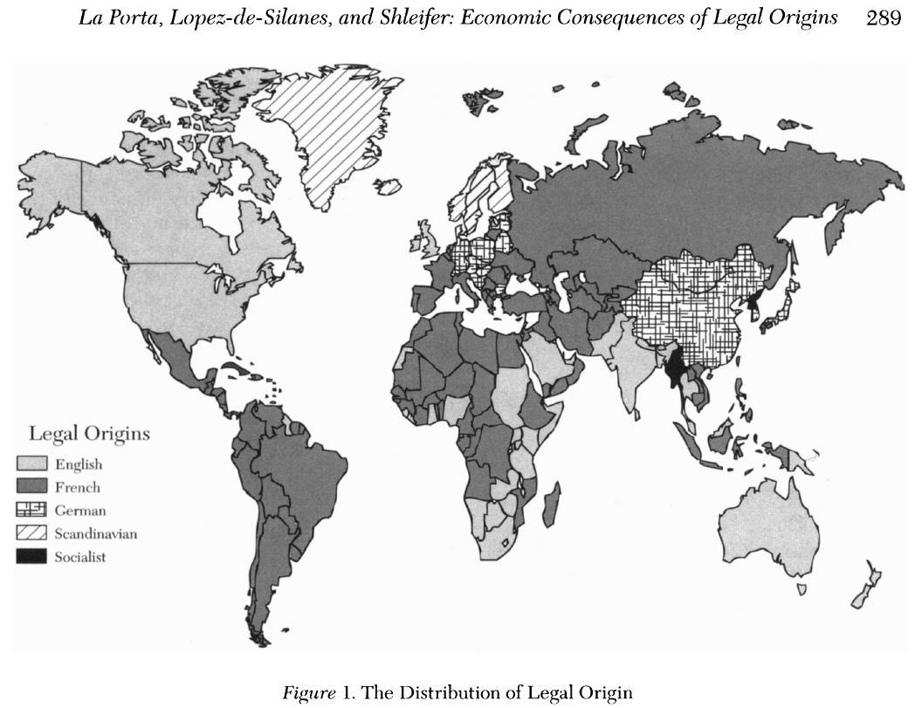
I. Summary 1. Question and its importance
Legal rules, legal enforcement, effect of the rules
Different countries could have substantially different rules
Substantially different rules might explain differences in development
4 legal families

Slide 4
I. Summary 2. Method and main result
Comparative statistical analysis of 49 countries:
Laws protecting investors
Quality of law enforcement
Effect on corporate ownership
What is the main result?
Laws differ markedly within the legal families
Law enforcement differs significantly within the legal families
Countries develop substitute mechanisms for poor investor protection

Slide 5
II. Paper’s question and contribution
What do we learn that we did not know before?
No systematic knowledge before (1998)
Substantially different rules might explain differences in financial patterns
How does the paper relate to economic theory?
Narrative: Weak investor protection laws actually make a difference
Poor investor rights and poor legal enforceability might come with a price
Notes:
Financial patterns:
Why do Italian companies rarely go puplic?
Why does Germany have such a small stock market but also maintain verly large and powerful banks?
Why is ownership of large American and British companies so widely dispersed?
NARRATIVE

Slide 6
III. Details of the paper
In what context do the authors test the hypothesis?
Comparative statistical analysis
Data from 1993
Why is this a good experiment?
Large amount of data
Covers many countries
No focus on a single incident
Notes:
There is no context
Could also be the weakness

Slide 7
IV. Data 1. Countries
Which countries did the authors pick?
49 countries from Europe, North and South America, Africa, Asia, Australia
No socialist or “transition” countries
Countries had at least five domestic nonfinancial publicly traded firms with no government ownership in 1993

Slide 8
IV. Data 2. Variables
What data do the authors use?
Category 1: Shareholder rights
7 different rights
e.g.: one-vote-one-share
Category 2: Creditor rights
4 different rights
e.g.: management does not stay in reorganization

Slide 9
IV. Data 2. Variables
What data do the authors use?
Category 3: Quality of legal enforcement and accounting standard
5 + 1 variables
e.g.: risk of expropriation
Category 4: Ownership
10 largest, domestic, totally private, publicly traded companies in each country
average and median of the combined ownership stake of the 3 largest shareholders of these companies

Slide 10
IV. Data 3. Variation and economic theory
There is no variation to test the hypothesis
What is the measure of “strong” investor rights?
Number of some investor rights are counted within the legal families
Estimation of the quality of law enforcement and accounting standards
Ownership concentration of large companies is determined
Notes:
However different countries are compared
Theory predicts strong property rights increase investment

Slide 11
V. Results 1. Investor and creditor rights within the legal families
Hypothesis: Substantially different rules -> differences in financial patterns
1. Common-Law Countries
2. German-& Scandinavian-Civil-Law Countries
3. French-Civil-Law Countries
Notes:
Common law countries: Considerably more investor protection compared to French-civil-law countries. German- & Scandinavian-civil-law: intermediate state.

Slide 12
V. Results 2. Quality of law enforcement and accounting standards
Hypothesis: Strong legal enforcement could substitute weak rules
1. German-& Scandinavian-Civil-Law Countries
2. Common-Law Countries
3. French-Civil-Law Countries
Notes:
German- & Scandinavian-civil-law countries –> Best quality of law enforcement, Strong in common-law-countries; weakest in French-civil-law countries

Slide 13
V. Results 3. Ownership concentration
Hypothesis: Poor investor protection -> ownership concentration
1. French-Civil-Law Countries
2. Common-Law Countries
3. German-& Scandinavian-Civil-Law Countries
Substitute mechanisms: Mandory dividends & legal reserve requirements
Notes:
Some statutory: Mandatory dividends or legal reserve requirements, OWNERSHIP concentration: strong negative correlation between concentration of ownership and the quality of legal protection of investors
Being on top is bad

Slide 14
V. Results 4. Summary
Laws differ markedly within the legal families
Law enforcement differs significantly within the legal families
Countries develop substitute mechanisms for poor investor protection / ownership concentration
Is the result consistent with economic theory?
Countries with good investor protection rights and/or good legal enforceability are the most developed

Slide 15
Structure
A. Law and Finance (1998)
B. The Economic Consequences of Legal Origins (2008)
C. Criticism

Slide 16
The Economic Consequences of Legal Origins (2008) 1. Summary
Follow-up paper
Legal Origin Theory
Addressed criticism

Slide 17
II. Explanations of the differences of GB & FRA 1. Revolunary Explanations
Explanation derives from the different nature of the revolutions:
Glorious Revolution
French Revolution
Notes:
Glorious Revolution: English judeges gained independence from the crown (lifetime appointments (1701) winning side – respect for private property in English law, especially against the crown
French Revolution: French judeges were on the loosing side. Largly monarchist. Revolutionist deprived judges of independence and law making power. Montesquieu – separation of powers – only source of law: legislation

Slide 18
II. Explanations of the differences of GB & FRA 1. Revolunary Explanations
Consequences for legal origins
Built-in judicial independence of common-law –> more respect for private property
Common-law: „dispute-resolving“
Civil-law: „policy-implementing“
Common-law will be more adaptable to changing circumstances
Notes:
Common law: Judicial resolution of private disputes
Legislation of Civil law: A solution to social problems
Greater respect for jurisprudence as a source of law in common law countries

Slide 19
III. Legal Origin Theory
England and Continental Europe (FRA) have developed very different styles of social control of business and institutions
Transplantation by the origin countries to most of the world
These styles have proved persistent in addressing social problems

Slide 20
IV. Addressed Criticism 1. Reverse causality
Narrative: Countries improve rules as consequence of development
But:
Legal origins are still exogenous
Criticism doesn‘t reflect the significance of legal origins in shaping outcomes
Greenstone et al. (2006) Weakened this critism by analysing changes in financial development in response to change in legal rules
Notes:
Countries improve their laws as their financial market develop, perhaps under political pressure form investors
Greenstone et al. (2006) Weakend this critism by analysing changes in financial development in response to change in legal rules

Slide 21
IV. Addressed Criticism 2. Omitted variables
Narrative: Legal origins could influence financial development through some other channel (e.g. contract enforcement or quality of judiciary)
But:
Results are still significant if controlled for judiciary quality
La Porta et al. (2006) control for contract enforcement -> both are important
Further studies: Combination most effective
Notes:
Judiciary quality = per capita income (proxy)

Slide 22
IV. Addressed Criticism 3. Culture
Narrative: Legal origins are merely a proxy for culture
But:
Religion is not nearly as important as investor rights (Djankov et al., 2007)
Most indices of cultural attitudes do not influence investor rights holding legal origin constant

Slide 23
IV. Addressed Criticism 4. Politics
Narrative: Legal origins are merely a proxy for politics
But:
Results remain significant in autocracies and democracies

Slide 24
IV. Addressed Criticism 5. History
Narrative: Legal origins are merely a proxy for (financial) history
But:
French-civil law countries had in 1913 more developed financial markets
Notes:
(Shareholder protection in Britain at the beginning of the twentieth century was minimal)

Slide 25
IV. Blueprint for policy reform
1.) To the extent that a country has a particular legal or regulatory style shaped by ist legal tradition, it might apply the tools characteristic of that style to areas of regulation where they are inappropriate
2.) Country that introduces legal and regulatory rules in a situation of extreme disorder may fail to return normal

Slide 26
V. Main results 1. Four propositions
1.) Legal rules and regulations differ systematically across countries
2.) Legal origins account for these differences to a significant extent
3.) Basic historical divergence in legal traditions explains why rules differ
4.) Measured differences in legal rules matter for economic and social outcomes
Notes:
1. Can be measured

Slide 27
V. Main results 2. Recap
Which institutions are responsible for financial development?
“Legal origins have significant consequences for the legal and regulatory framework of the society, as well as for economic outcomes”
Notes:
Big picture question

Slide 28
Structure
A. Law and Finance (1998)
B. The Economic Consequences of Legal Origins (2008)
C. Criticism

Slide 29
C. Criticism
“France and Belgium, after all, are both very rich countries”
There is no treatment, they are still different countries
“One” “legal family”
Variables (random, estimated)
Development before middle age
Notes:
Risk of expropriation

Slide 30
Which institutions are responsible for financial development?
“Legal origins have significant consequences for the legal and regulatory framework of the society, as well as for economic outcomes”
Notes:
Big picture question

